Slide 1

Contact Center
Agent Assistant - Real-time Apps
Presentation Title
The UiPath ™ word mark, logos, and robots are registered trademarks owned by UiPath, Inc. and its affiliates. ©2023 UiPath. All rights reserved.

Slide 2


2023 Telecom focus areas
Improve the customer and employee experience, improve efficiency, and grow revenue
62%
of Telcos surveyed say automation is the most critical driver for digital transformation journey over next 5 years
EY Global telecommunications study 2019-20. Accelerating the intelligent enterprise.
Declining customer experiences
Annual headcount reduction causing workforce burnout
Complex and fragmented processes
Slow revenue realization
Notes:
Today, we'll delve into the telecom industry—a sector marked by relentless cost pressures and shrinking margins. As C-level executives navigate a delicate balancing act involving strategy, operations, employee engagement, and digital transformation, they face the complexity of compounding processes driven by a growing number of applications, heightened compliance, and sustainability demands.
Amidst these challenges, employees find themselves yearning for increased productivity and empowerment, despite facing regular headcount reductions and being immersed in mundane, lower-value tasks. Additionally, the industry grapples with stagnant or declining revenues and customer expectations that demand quick issue resolution and superior service.
It's within this landscape that UiPath steps in. With our market-leading, AI-powered business automation platform, we aim to alleviate the administrative burdens placed on employees and enhance the customer experience. We believe that by embracing automation, the telecom industry can not only tackle its current challenges but also unlock new opportunities for growth and transformation.

Slide 3




Key automation areas identified by industry experts and embraced by our Telecom customers
Customer Experience | Service Delivery | Field technician Efficiency | Migration and Testing
40% | >50% | >25% | 10k
of Telecom customers express dissatisfaction with their providers due to lengthy wait times for query and complaint resolutions, increasing churn risk. | Of IP orders are prone to errors, due to complex processes and manual hand-offs from order entry to provisioning, activation and assurance causing service delivery inefficiencies and revenue delays | Of field technician time associated with data uploads and downloads, before and after site visits. This reduces their ability to focus on problem-solving and resolution, and hinders operational efficiency | test cases are run monthly that are fragmented, and expensive. Obtaining test results is often delayed, hindering testing and efficiency.
Notes:
Now that we've discussed the challenges, let's explore the exciting opportunities for automation within the telecom industry. Our experts have identified four key business areas where automation can deliver significant value, allowing you to start or continue your automation journey.
First, let's focus on customer experience. We're here to help you provide swift resolutions and personalized care to your customers. Imagine supporting your agents and customer-facing teams with robots that can simultaneously access multiple systems, delivering crucial information to resolve customer issues at the very first point of contact.
Next up is service delivery. We empower you to facilitate accurate and faster order management and provisioning. Our robots are capable of swiftly entering customer order data into multiple systems, streamlining the entire process for efficiency and accuracy.
Moving on to field technician efficiency. We understand the importance of higher employee engagement and increased productivity. Our robots support technicians by gathering and downloading customer information required for their jobs upon arrival. They also seamlessly update information in various apps, including billing systems, ensuring a smoother workflow.
Lastly, let's talk about migration and testing. Our automation solutions enable you to improve efficiency significantly. By adopting robots for data migration, you can reduce testing time by up to 80%, making complex migrations more manageable and less time-consuming.
In summary, these are the four key business areas where UiPath can help you drive automation and unlock substantial value within the telecom industry. Whether it's enhancing customer experience, streamlining service delivery, optimizing field technician operations, or expediting migrations and testing, we're here to support your automation journey every step of the way.

Slide 4







Customer Experience
“
With UiPath, you can:
The outcome:
In the competitive telecom environment, delivering an exceptional and frictionless customer experience is paramount. Telecoms are exploring options to excel in customer service, while minimizing expenses, and enhancing operational efficiency. Today's customers demand prompt attention, swift resolutions, and personalized care.
Support agents with robots that simultaneously access multiple systems to provide the information that resolves issues at the first point
accurately anticipate customer requirements with alerts on churn probabilities and next action
understand context of incoming complaints/queries and sentiment, real time. Robots then, triage issues responds to customers, update CRM or route exceptions to SME.
First point resolution and increased NPS | Reduce burden on staff, with automated scripts for common queries
Reduce agent errors, with consistent customer experience | Churn risk highlighted with next action, increasing customer lifetime value
63% improvement average handling time
Attended automation utilized to work in parallel with agents, simultaneously accessing multiple systems and providing information to agents, reducing AHT by 63% and improving the customer experience
Notes:
In today's telecom landscape, consumers expect nothing less than a seamless, frictionless experience. That's where AI-powered business automation steps in, helping telecoms achieve remarkable improvements in customer service and satisfaction.
Our automation solutions enable first-point resolution, ensuring that customer issues are addressed comprehensively and swiftly during their initial contact with your support team.
We help telecoms understand customers at risk of churn and prioritize issue resolution. By proactively identifying and addressing potential concerns, you can retain more customers and reduce churn rates.
Our automation solutions offer consistent and efficient onboarding and offboarding processes for both agents and customers, ensuring a seamless experience.
You can customize ongoing agent training programs, ensuring that your team is always equipped with the latest knowledge and skills to serve customers effectively.
Our automation tools provide automated scripts to assist agents during customer calls, enhancing their ability to provide accurate and efficient support.
Our AI systems understand the context of incoming complaints and queries, analyzing customer sentiment in real time. Robots then triage issues, respond to customers, update your CRM, or route exceptions to subject matter experts.

Slide 5



Process background
The basics
The telecom contact center has a process in customer support system where dedicated agents address telecommunications-related issues, such as network outages and service plan management, by logging service tickets and ensuring swift issue resolution.
Executive KPIs: CSAT, FCR,AHT, Cost Per Contact
Business impact and challenges
Businesses face inefficiencies, increased errors, and higher operational costs due to manual handling of repetitive tasks. Additionally, employee morale may suffer, and the ability to scale and adapt to changing demands can be limited.
Increased Operational Costs
Lower
Customer Satisfaction
Higher
AHT leading to high backlog
Notes:
In the telecom contact center, dedicated agents play a crucial role in addressing telecommunications-related issues, ranging from network outages to service plan management. They ensure swift issue resolution by logging service tickets and providing top-notch customer support.
Manual handling of repetitive tasks can lead to increased operational costs. The need for more labor hours, particularly for routine tasks, can strain operational budgets.
Customer satisfaction can take a hit when manual processes result in errors or extended handling times. A dissatisfied customer base can lead to customer churn and negative impacts on the brand.
Lengthy Average Handle Times (AHT) can contribute to a backlog of unresolved customer issues. This backlog can further reduce customer satisfaction and hinder the ability to address new inquiries promptly.
Inefficiencies, errors, and increased operational costs are at the forefront of the challenges faced by telecom contact centers. Additionally, employee morale can suffer when they are burdened with repetitive tasks. These challenges emphasize the need for automation to enhance operational efficiency and customer service quality.

Slide 6



UiPath solution
How does UiPath solve this problem?
Task Automation: UiPath Real-time Apps automate repetitive tasks such as incident ticket creation, outage checks, and router refresh, reducing manual effort and enhancing efficiency.
User-Friendly Interface: The solution offers a user-friendly UI for agents, enabling them to initiate and monitor tasks in real time. Agents can access results and updates conveniently within the app.
On-Demand Efficiency: Agents can trigger automated tasks on demand, improving response times and customer service quality while streamlining processes in the Contact Center.
What is the value of this solution?
UiPath's Real-time Apps streamline Contact Center operations by automating repetitive tasks, enhancing agent efficiency, and providing a user-friendly interface for on-demand task execution and monitoring.
Operational Efficiency
Enhanced Customer Service
Scalability
Notes:
Now, let's explore how UiPath addresses the challenges faced by telecom contact centers and how our solution can transform operations. UiPath Real-time Apps are designed to run automated repetitive tasks in real-time within the telecom contact center. These tasks encompass incident ticket creation, outage checks, router refresh, and more. By automating these processes, we significantly reduce manual effort, enhance efficiency, and free up valuable agent time.
Our solution offers a user-friendly interface tailored for agents. This intuitive UI empowers agents to initiate and monitor tasks in real time with ease. Agents can conveniently access results and updates directly within the application, streamlining their workflow.
One of the key advantages of UiPath's Real-time Apps is the ability to trigger automated tasks on demand. This feature not only improves response times but also elevates the quality of customer service. It allows agents to focus on more complex issues while routine tasks are handled efficiently by automation.
So, what is the value of this solution for telecom contact centers?
First and foremost, UiPath's Real-time Apps bring operational efficiency to the forefront. By automating repetitive tasks, telecom contact centers can achieve cost savings, reduce errors, and streamline processes for optimal performance.
Enhanced customer service is a direct outcome of our solution. With automation handling routine tasks, agents can devote more time and attention to complex customer inquiries, resulting in improved customer satisfaction and loyalty.
Scalability is a key advantage of our solution. As telecom contact centers grow and adapt to changing demands, UiPath's Real-time Apps can seamlessly scale to accommodate increased workloads, ensuring efficient operations even during periods of expansion.
In summary, UiPath's solution for telecom contact centers not only automates tasks but also delivers tangible value. It enhances operational efficiency, elevates customer service, and offers scalability to meet evolving business needs

Slide 7

Personas
Call Center Agent
Jane
Notes:
In this Demo scenario featuring a fictional company, our central character is Jane, a dedicated call center agent. During a standard customer interaction, Jane's primary tasks include gathering crucial user information and details about the raised issue. Subsequently, she proceeds to create a service ticket, marking the beginning of her efforts to address the customer's concerns.
Throughout this process, Jane adeptly utilizes the various tools and systems at her disposal, all while maintaining an active conversation with the customer over the phone. Her goal is to efficiently and effectively resolve the issue, ensuring a seamless experience for the customer.
Once the service ticket reaches its resolution stage, Jane has the flexibility to either update the ticket or conclude it, depending on whether the issue has been fully or partially resolved. Let’s see Jane making use of UiPath’s Agent Assistant in one of her customer Interactions

Slide 8
Customer Support – Agent Assistant
Notes:
Jane initiates the customer interaction by clicking the "Next Caller" button, prompting the caller's details to appear on her screen. Behind the scenes, automation swiftly goes to work, seamlessly collecting all the necessary information. After that, as Jane engages with the customer to understand his issue, automation takes the proactive step of initiating a service ticket creation, recognizing it as Jane's primary task at this stage.
During the conversation, the caller expresses the desire to activate roaming on their phone. Jane promptly addresses this request by clicking the "Toggle Roaming" button. The robot swiftly responds, toggling the roaming setting on the customer's device screen. Once the robot finishes its task, App screen gets updated with corresponding work note summarizing the action taken by the robot.
Subsequently, the customer requests the removal of a specific data plan from their account, as it is no longer needed. Jane efficiently updates the App screen, and the robots immediately replicate these changes on the customer's settings.
In a further display of efficiency, Jane suggests a more suitable plan to the customer during the call. The robots, adept at handling Jane’s tasks, gives her the time to explain the plan’s benefit to the customer. She swiftly modifies the plan, and the robots respond promptly by adjusting the customer's settings.
Throughout these automated actions, each task performed by the robot generates a corresponding work note, ensuring a detailed record of the interaction.
As Jane prepares to transition to the next caller, she efficiently closes the ticket. She sets the ticket status and resolution code with the appropriate values, and the attached work notes are seamlessly integrated into the ticket, preserving a comprehensive record of the interaction. Once the ticket is closed on the system, the same status is seen on the Apps screen by Jane. This means Jane can now complete the whole conversation with the customer without switching a single screen, Apps helps in bringing the power of multiple systems to a single app for Jane.

Slide 9


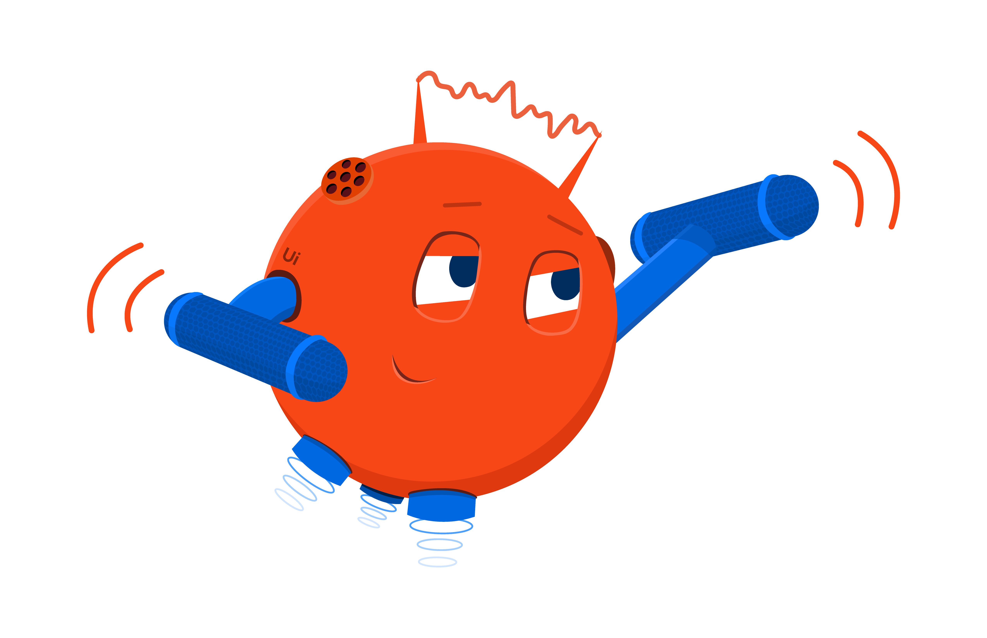
Telecom Customer Support System
100%
human effort
10%
human effort
Use Case: Contact Center
90%
robot
60% reduction in AHT
67% increase in call handling capacity
90% reduction in human efforts
2080 hours/agent
208 hours/agent
Customer reports an issue
Customer reports an issue
Collects customer information/issue details
Collects customer information/issue details
Create incident task
Create incident task
Perform tasks to handle customer issue
Perform tasks to handle customer issue
Update incident task with work notes
Update incident task with work notes
Escalate if not resolved
Escalate if not resolved
Location: Global
Customer type: Telecom
Products and bot types used: attended bots, real-time apps, integration service
Resolve ticket with Resolution notes
Resolve ticket with Resolution notes
TASK
COMPLETED
Notes:
With UiPath's Real-time Apps, we achieve an impressive 90% automation effort. This means that the majority of repetitive tasks are now handled seamlessly by automation, freeing up valuable agent time.
We've witnessed a significant 60% reduction in Average Handle Time (AHT). This translates to shorter interactions with customers, all while achieving the same positive results.
Our solution enables a remarkable 67% increase in call handling capacity. This means that customers experience less wait time and quicker issue resolution—an improvement that directly impacts customer satisfaction.
Automation not only enhances productivity but also contributes to increased employee happiness. Agents can focus on more meaningful and engaging tasks, leading to higher job satisfaction. Calculations: Assuming 2000 calls per day and each customer interaction lasting for 15mins before automation. With 60% reduction in AHT (with 75% faster execution of repetitive tasks and taking into account stable human actions time).

Slide 10

Customer Highlight – Vodacom (Africa)
Enhancing experiences with human-centric intelligent automation
EMEA
400
60
Telecommunications
Enterprise-wide
Robots across 5 countries in 4 years
Citizen developers
Platform
Challenge
Vodafone subsidiary Vodacom has a vision to evolve from telco to tech company by 2025. Digital transformation is key to this, and automation is a major step in the business’s overall strategy. As part of this transition, Vodacom wanted to make the customer journey smoother, reducing churn and driving efficiencies across its operations in Africa. And Vodacom wanted to ensure that employees were a key part of this transformation.
“I like to describe automation as unlimited hands-on keyboards. At Vodacom, we have so many different products—what’s the point of a human agent going through all these to find the best fit for a customer when a bot can do a better, faster job? Our account managers can focus on what they do best: engaging with customers.” Ati Ngubevana Group Executive
Solution
Supported by UiPath, Vodacom embarked on an enterprise-wide citizen developer program that has delivered over 400 automations across five countries and in every vertical in the Vodacom business – from customer care to finance, technology, network, compliance, and its consumer enterprise business. Combining ML and automation, teams are now empowered to be more productive—fully supported by what the telco describes as human-centered intelligent automation. Potential problems are proactively identified before they affect customers, leading to fewer calls to customer care centers and less churn across its network.
Processes Automated
Customer care
Notes:
Let's dive into the remarkable success story of Vodacom, powered by UiPath's support in their enterprise-wide citizen developer program.
With UiPath's assistance, Vodacom embarked on an enterprise-wide citizen developer program that has yielded impressive results. They've successfully deployed over 400 robots across five countries, spanning every vertical in Vodacom's business, from customer care to finance, technology, network, compliance, and consumer enterprise.
Vodacom's teams have harnessed the power of Machine Learning (ML) and automation, empowering them to be more productive than ever before. This combination of technologies has led to what Vodacom describes as "human-centered intelligent automation."
One of the program's remarkable outcomes is the proactive identification of potential problems before they impact customers. This proactive approach has resulted in fewer calls to customer care centers and reduced churn across Vodacom’s network.
Over the course of four years, Vodacom has successfully deployed a total of 400 robots across five different countries. This expansive deployment showcases the scalability and impact of UiPath's automation solutions.
Vodacom’s commitment to empowering its teams is evident in the preparation of 60 citizen developers. These individuals have acquired the skills and knowledge necessary to contribute to the automation journey, further solidifying Vodacom’s commitment to innovation.

Slide 11

Customer Highlight – Carglass
Leveraging automation and UiPath Apps to deliver better customer service, improve employee experience and unlock more sales.
EMEA
25
99%
Automotive
Finance, HR, Customer contact centers
Additional FTE resources enabled
Technicians who had positive experiences with Apps
Platform, UiPath Apps
Challenge
Carglass is committed to delivering best-in class service to millions of drivers. As windshield repair requires a significant amount of back and forth with insurance companies, service agents were overwhelmed with the work needed to collect and process insurance claims. Adding to that, they worked with applications that required a fair amount of manual input.
“When you come with something that’s better than they already have, the change is accepted really fast by employees. In this case, we gave them so many more possibilities so they took in the new app with open arms.”
Michael Jeppesen RPA Developer
Solution
Carglass started automating invoicing process, reporting results in less than two weeks. Now 200 automations are helping. They wanted to offer agents an easy interface to interact with their automations on-the-go. With UiPath Apps’ low-code platform for building elegant, automation-powered interfaces, they built three useful apps. Admin employees were spending two hours/day manually correcting data input. Thanks to UiPath Apps, ”This is down to 20 minutes a day". As technicians have a simple interface, it's easier to sell more products during repairs.
Processes Automated
Windshield repair invoicing
Notes:
Let's delve into the impressive success story of Carglass, where UiPath played a pivotal role in transforming their operations.
Carglass initiated their automation journey with the invoicing process, and the results were remarkable. In less than two weeks, they successfully automated the invoicing process, demonstrating the speed and efficiency of UiPath's automation solutions.
Building on their initial success, Acme continued to leverage UiPath's capabilities. They now have a total of 200 automations in place, contributing to increased efficiency and productivity across their operations.
Recognizing the need to offer agents a user-friendly interface for interacting with automations on-the-go, Carglass turned to UiPath Apps. With the low-code platform for building elegant automation-powered interfaces, they developed three highly useful apps.
Carglass’s administrative employees were spending two hours a day manually correcting data input. Thanks to UiPath Apps, this time-consuming task has been dramatically reduced to just 20 minutes a day, freeing up valuable resources.
Technicians now have a simplified interface, making it easier for them to sell additional products during repairs. This not only benefits the technicians but also contributes to increased revenue opportunities for Carglass.
Carglass's automation journey has enabled the equivalent of 25 full-time employees (FTEs) to focus on more strategic tasks. This is a testament to the transformative power of automation.
An astounding 99% of technicians reported a positive experience with UiPath Apps. This high satisfaction rate reflects the user-friendly and impactful nature of the solution.

Slide 12

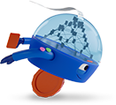
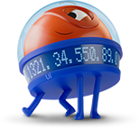
The UiPath Business Automation Platform
Discover
Continuously uncover opportunities for process and task improvements, ​helping you identify the highest ROI areas
Process Mining
Task Mining
communications Mining
Idea capture & management
Automate
Get more done with a digital workforce that seamlessly collaborates with your people ​and automates work via UI and API, powered with native integrated AI​
Low-code Development​
UI & API Automation​
Process Orchestration​
Intelligent Document Processing​
Integrated NLP & AI/ML
Operate
Get an enterprise-grade foundation to run and optimize a ​mission-critical automation program at high scale
Analytics
Continuous testing
Unified Management & Governance​
Flexible deployment
Your Processes
Your Applications
Your People
Systems of record – ERP, CRM, HCM | Communications and Collaboration | Personal Productivity​
Notes:
In the pursuit of profitable growth, cost transformation, enhanced employee engagement, and improved patient experiences, businesses face a monumental challenge. Operating more efficiently and innovating effectively requires more than just intention—it demands a seamless integration of processes across your business applications and the work performed by your teams.
Enter the UiPath Business Automation Platform—an AI-powered solution designed to make your transformation aspirations a reality. This comprehensive, healthcare enterprise-ready platform is engineered to connect your people, streamline your processes, and integrate seamlessly with your applications. The result? The ability to swiftly implement process changes that lead to genuine transformation.
The heart of UiPath's platform lies in its capacity to connect your people, your processes, and your applications. By creating this cohesive ecosystem, you gain the capability to drive meaningful change across your organization quickly and efficiently.
The ultimate goal is not just change but true transformation. UiPath's platform empowers you to implement these transformative changes swiftly, fostering an environment where growth, cost-efficiency, employee engagement, and patient experiences can thrive.
The path to transformation is a journey worth undertaking, and the UiPath Business Automation Platform is your steadfast partner along the way. It's not just about realizing the potential for change; it's about making that potential a reality.
In summary, UiPath's platform is the catalyst for propelling your organization toward profitable growth, cost optimization, enhanced employee engagement, and superior patient experiences. It's the key to turning your transformative aspirations into tangible achievements, quickly and efficiently.
Let's embark on this journey together and unlock the full potential of your organization's transformation.

